Slide 1
Southern Nevada DMV Service Center
Serving the Clark County Population

Slide 2
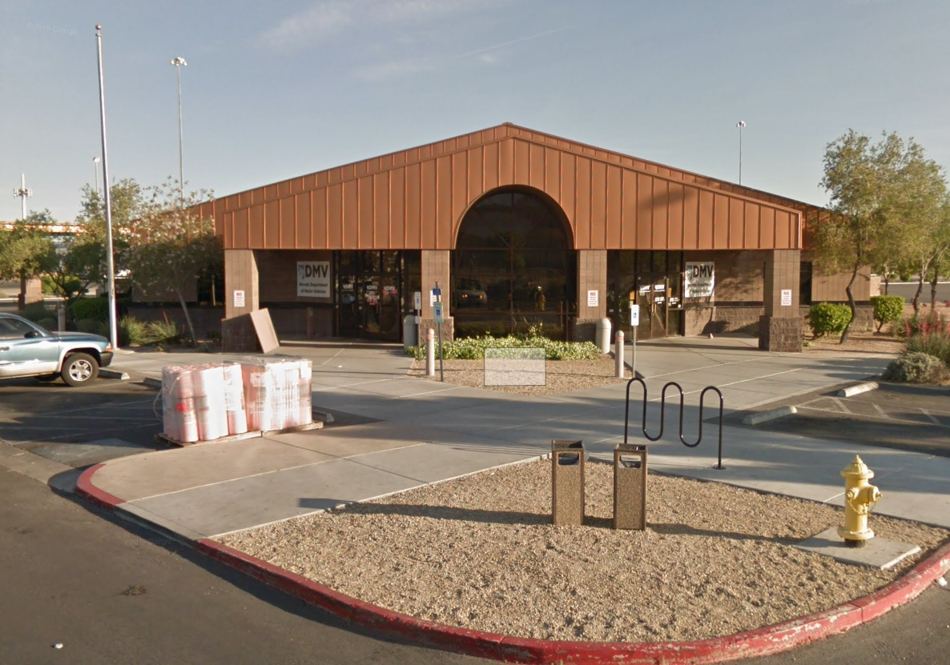
Why a new full service DMV facility
Donovan Express CDL facility constructed in 1995.
Donovan facility is located in an industrial area of North Las Vegas and customers complain about poor access to the site.
Due to population growth, the facility cannot accommodate the increase of walk-in customers. Lines form outside the building in +100ºF heat.
Classroom for 3rd Party Program training is too small.
Restrooms, offices, breakroom, customer counters, etc. need extensive refurbishment.

Slide 3
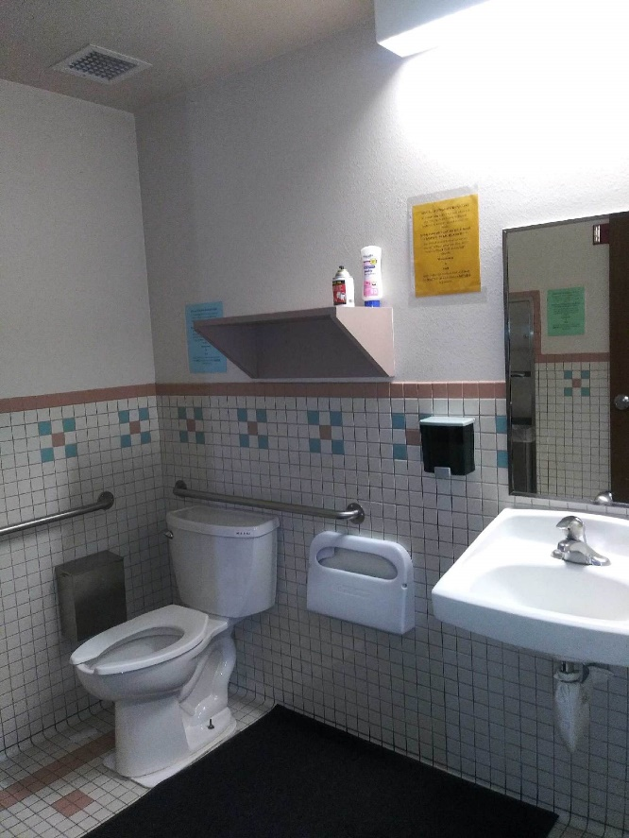
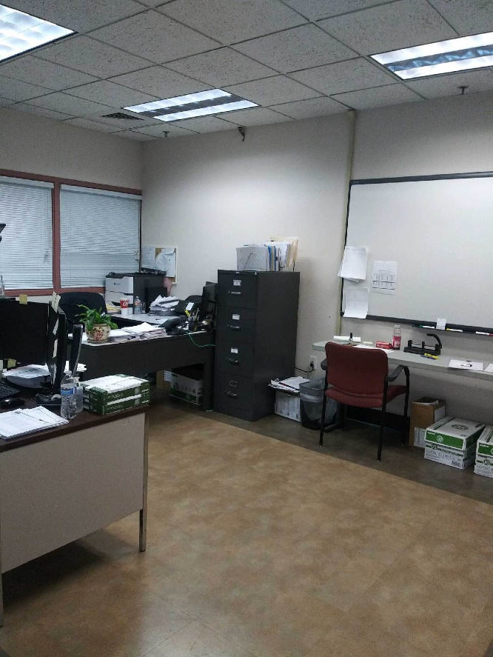
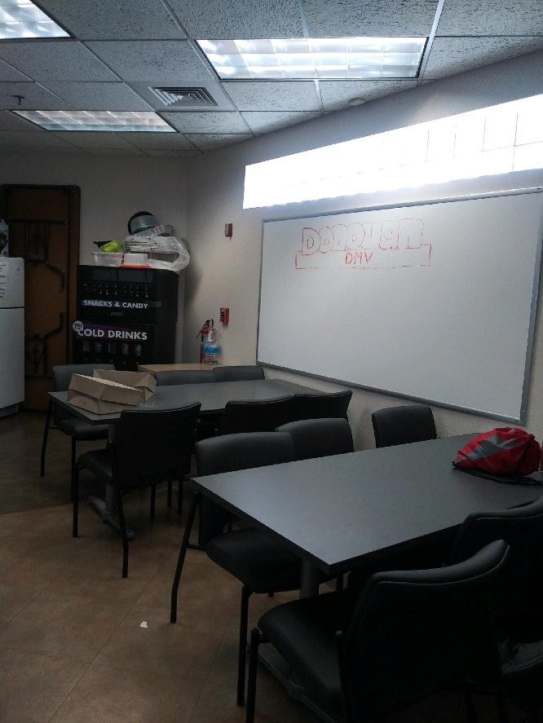
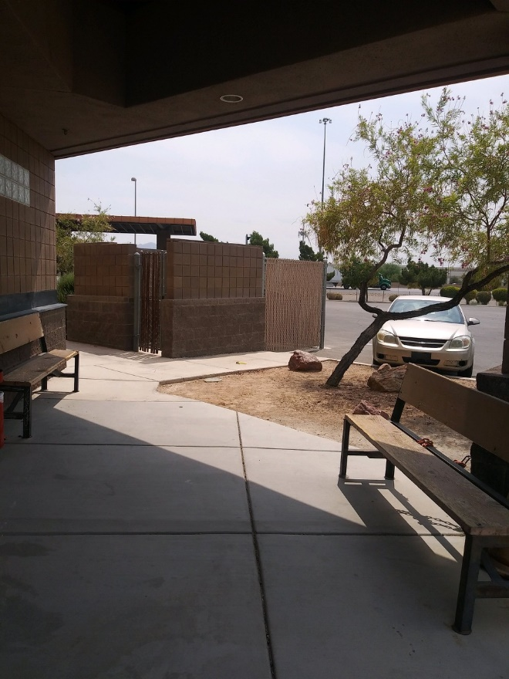
Some of the problem areas at Donovan:
Breakroom
Outside Break Area
Restroom
3rd Party Testing

Slide 4
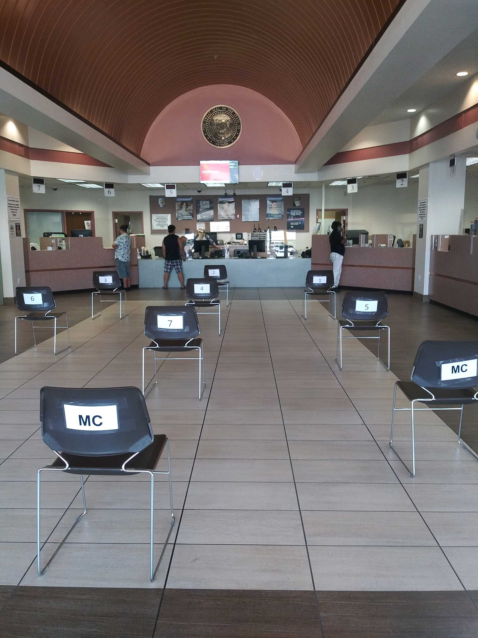
Relevant Data in Numbers …
DMV Donovan Location
Avg. Customer Wait Time (in minutes) | 40
Customer Service Windows Available | 9
Employees on Location | 21
Average Customers Served per Day | 285
Total Parking Spaces Available | 94

Slide 5
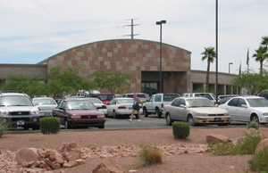
Why a new full service DMV facility
Henderson DMV facility constructed in 1997.
The property on which the facility is located does not allow the potential for growth.
Parking lot is too small which causes customer frustration.
Customer counters are not ADA compliant and were built when electronic equipment used was minimal.
Due to the customer lobby shape, customers cross over each other when navigating their way through the building. Other areas of the building such as restrooms, offices, lighting, architectural aesthetics need extensive refurbishment.

Slide 6
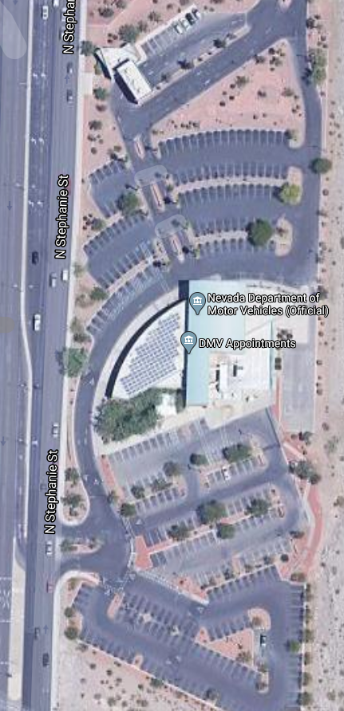
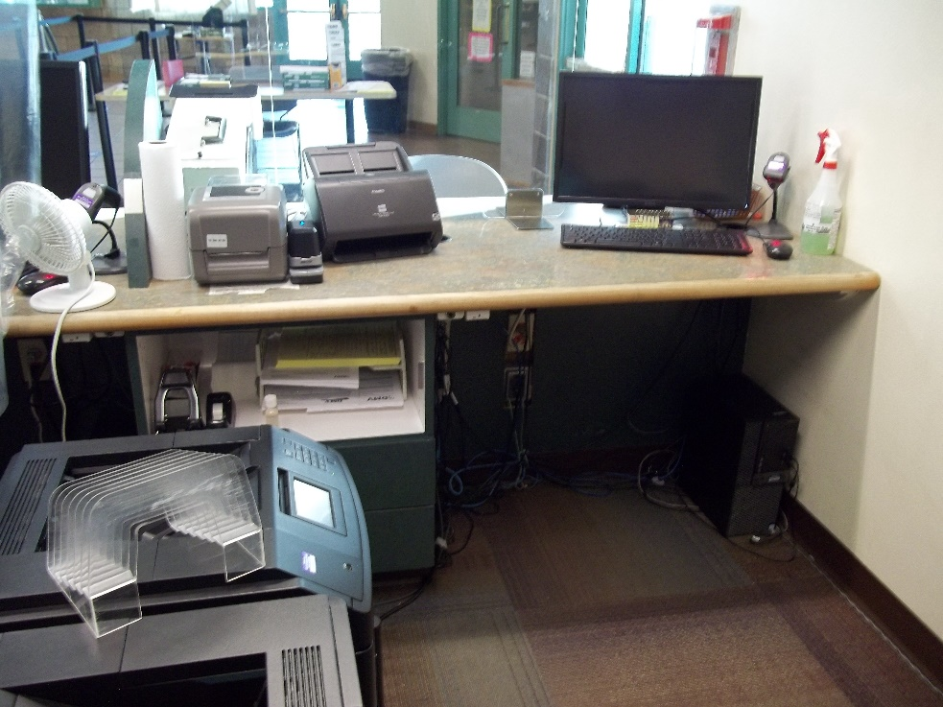
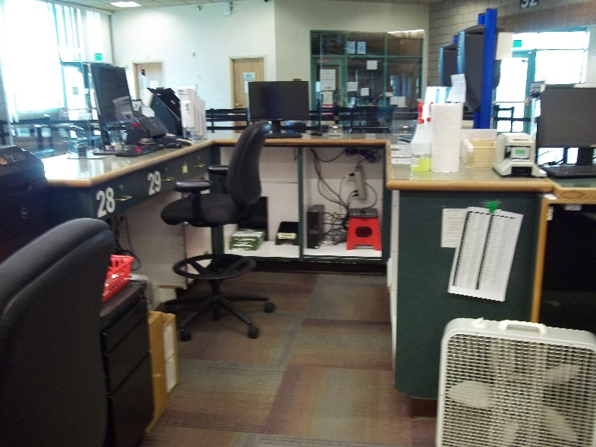
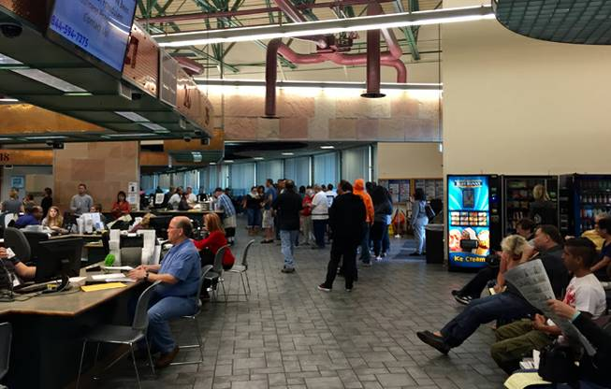
Some of the problem areas:
Cramped countertops
Lack of parking spaces
Cramped countertops
Customer lobby space minimal.

Slide 7
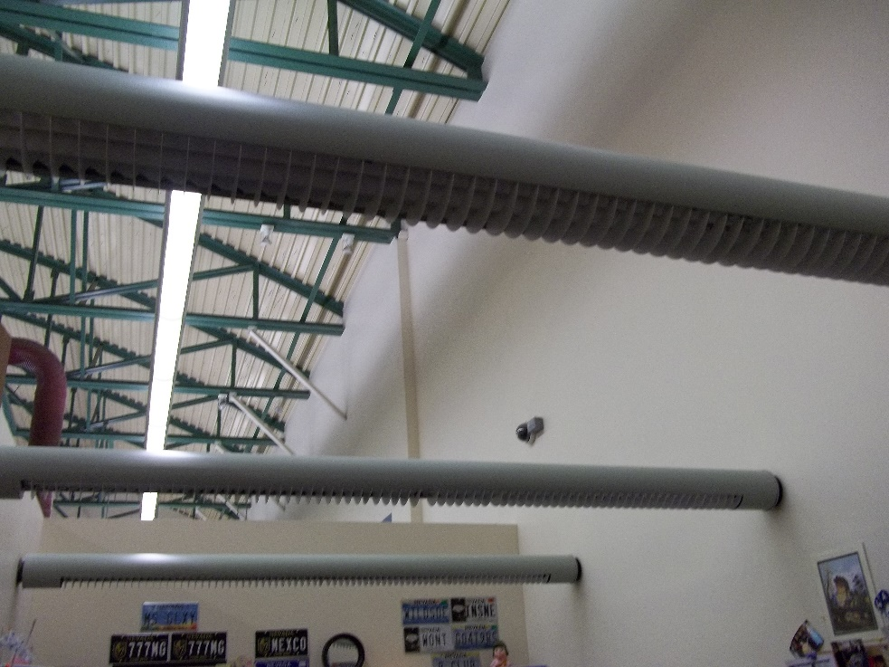
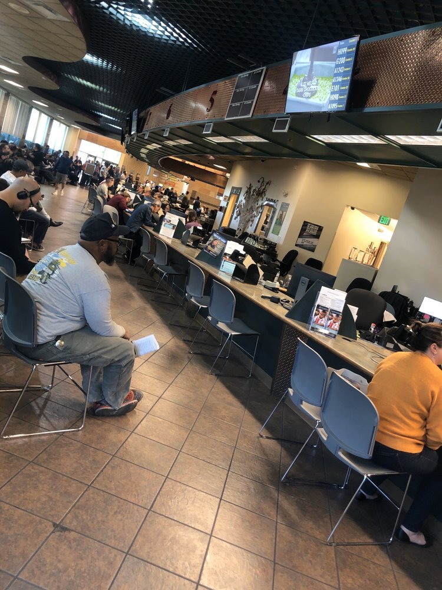
Supervisor’s office with no ceiling
Makeshift counters
Lobby area view

Slide 8
Relevant Data in Numbers …
DMV Henderson Location
Avg. Customer Wait Time (in minutes) | 54
Customer Service Windows Available | 38
Employees on Location | 122
Average Customers Served per Day | 1,300
Total Parking Spaces Available | 259

Slide 9
Population of Clark County

Slide 10
It’s Time…
To meet the growing demand of the Clark County population.
To reduce customer and employee frustration.
For a new Southern Nevada DMV Services Center.

Slide 11
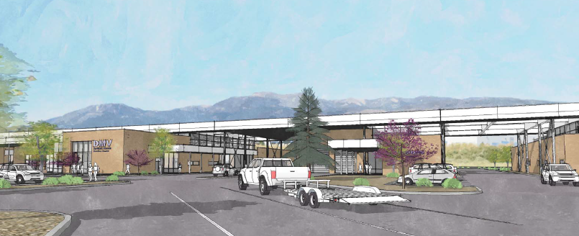
Southern Nevada Services Center
Combined DMV, Emissions, and Commercial Driver’s License Facility

Slide 12
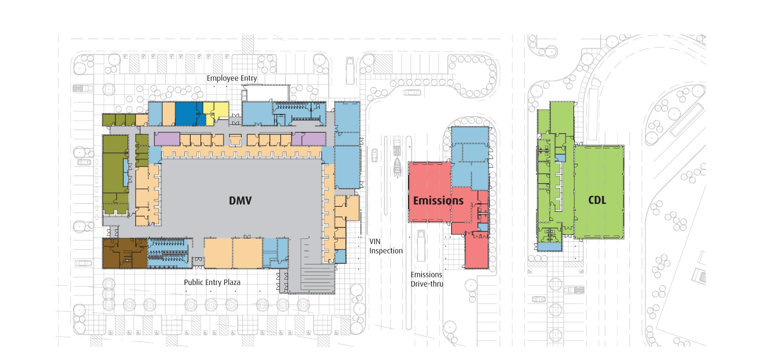
A one-stop service center:
Reducing confusion and frustration while
improving customer experience.

Slide 13
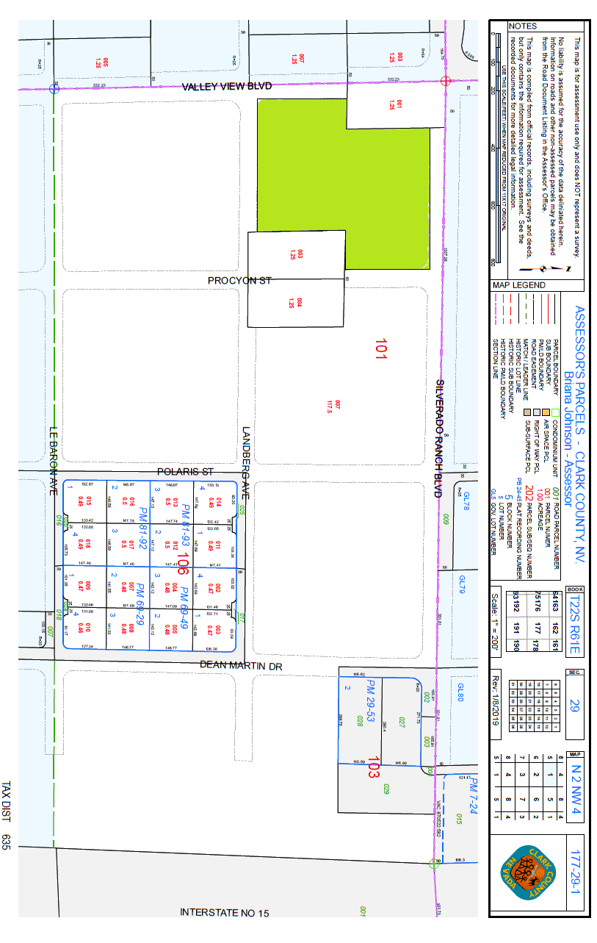
Location & Background
20-acre property leased through State Lands Office from federal BLM.
Advanced planning & schematic design already completed by Tate Snyder Kimsey. Construction design yet to be done.
Plan was approved as part of CIP 11-E04
NOT a General Fund Project.
Location is not in a residential zone and is easily accessible via I-15

Slide 14
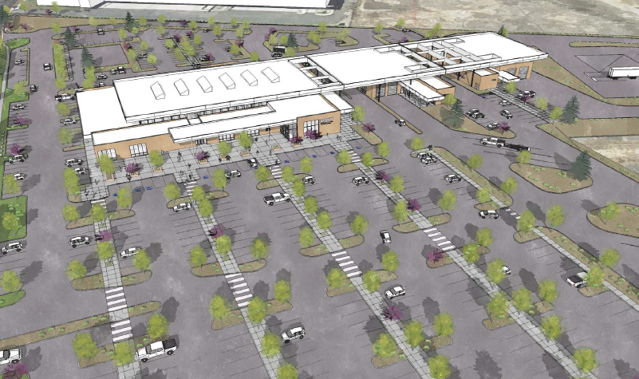
Parking & Access
If approved, and the South Reno plan is used, the new Southern Nevada DMV Service Center would offer enough parking to accommodate the needs of the staff and customers, including:
350 parking spaces for customers
143 spaces for employees
23 designated disabled parking spaces

Slide 15
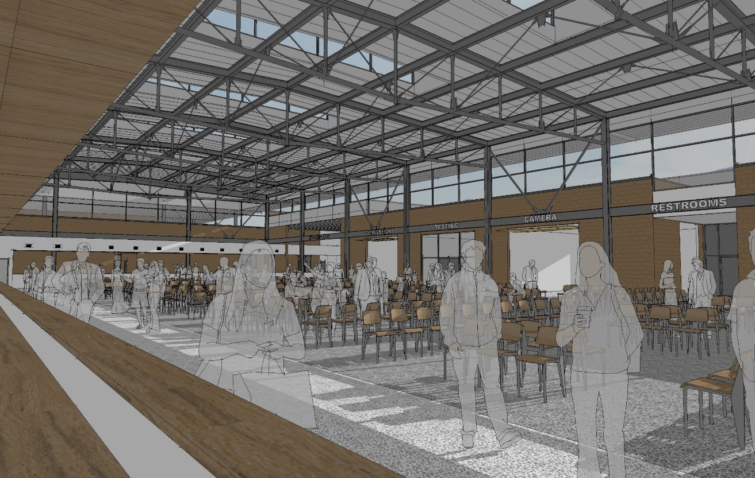
Increasing Capacity & Impact
49 Service Windows available to serve customers, decreasing wait time
Provide secure breakroom and work conditions for employees
Increase restroom facilities to accommodate customers & staff
Improved safety and ADA features
Allows for population growth

Slide 16
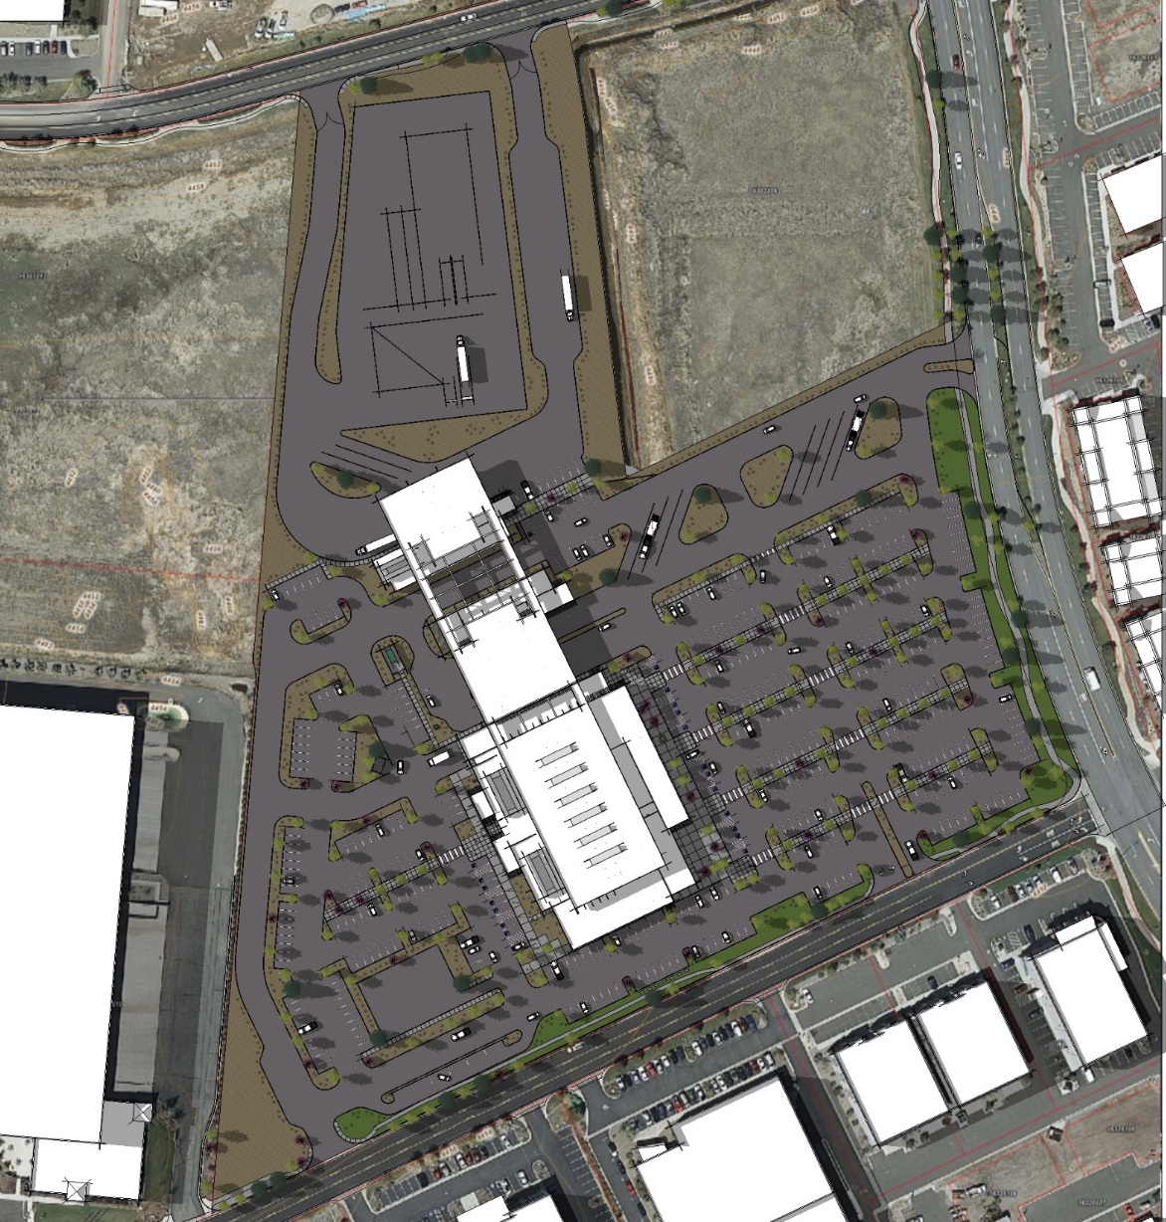
Thank You For Your Attention.

